Slide 1
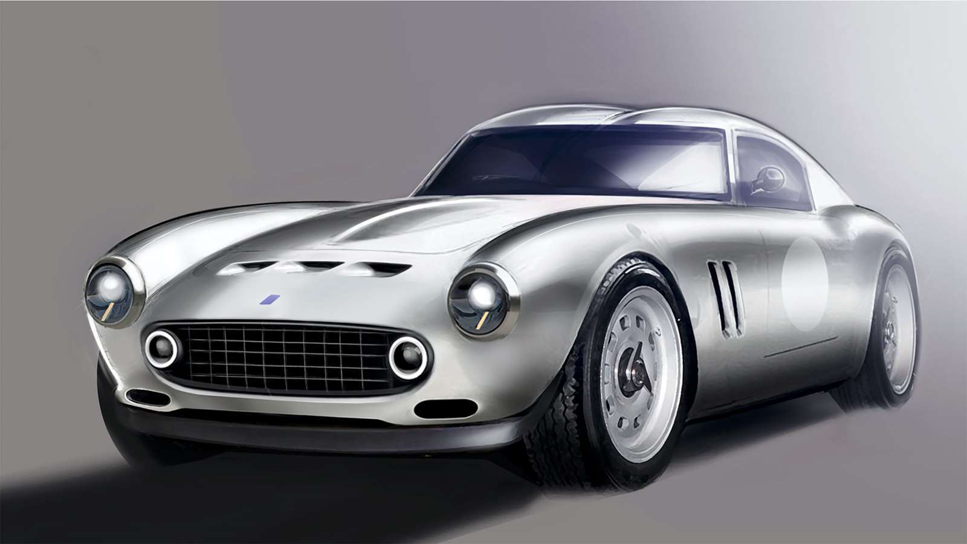
CLASSIC MODELS LTD. BI SOLUTION
Lucas Mata, July 2021

Slide 2
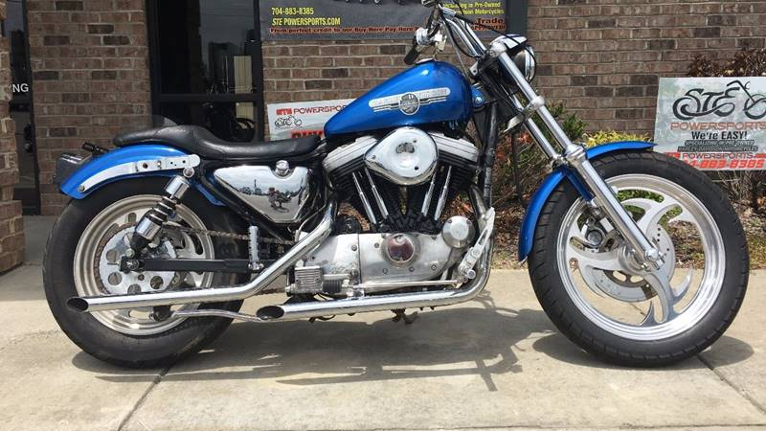
OBJECTIVE
“To create a Business Intelligence tool that informs Business performance to C-Level Stakeholders and Sales Representatives”.

Slide 3
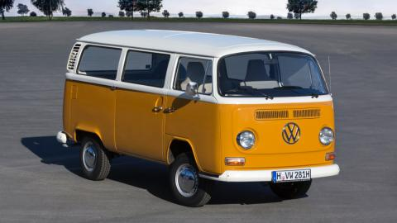
BUSINESS MODEL
GLOBAL WHOLESALER THAT SELLS MINIATURE REPLICAS OF CLASSIC VEHICLES
DATASET
  8 Tables
  27 Countries
  98 Customers
  8 Categories
  109 Products
  2.5 Years of Sales
PROCESS
  SQL Querying
  Visualisation with Tableau
  Feature Engineering/Calculated fields

Slide 4
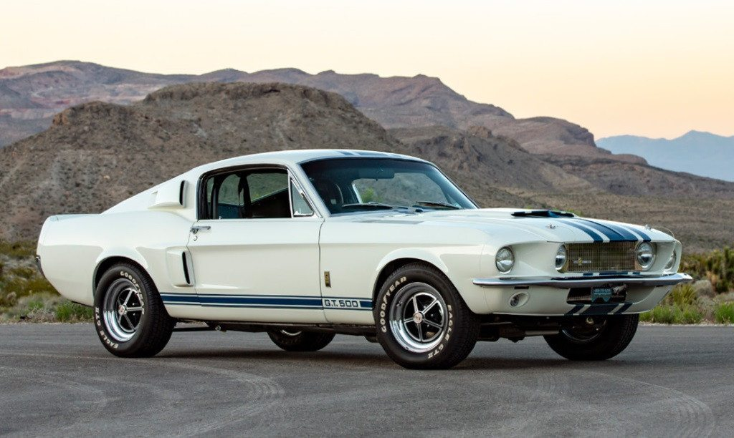
THANK YOU
Dashboard here

Slide 5
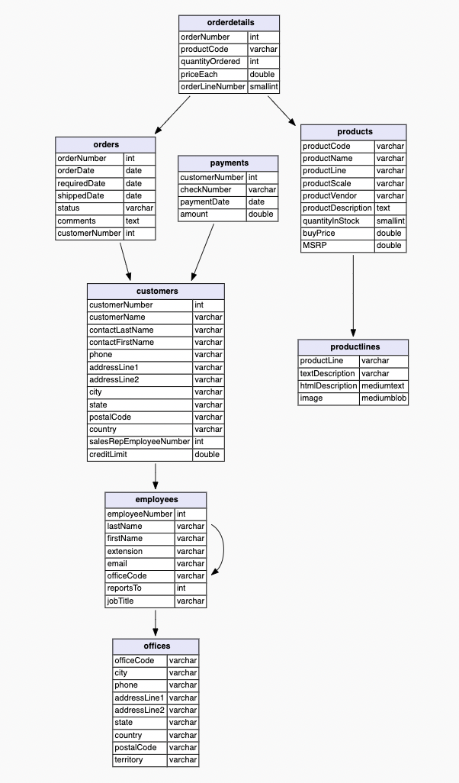
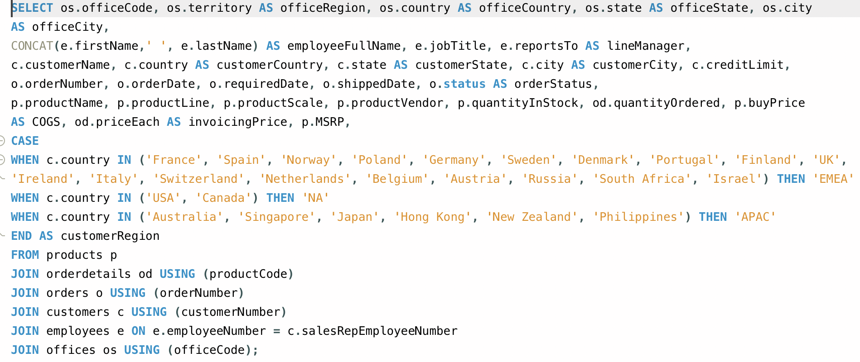
ANNEX

